Slide 1

BUSINESS AND
DATA ANALYTICS
Business and Data Analytics
Tyler West, Tosan Johnson, Phoenix Jitpaisarnsook, Vivian Kim,
Meg Garland, Keyu Chen
Vivian Kim, Phoenix Jitpaisarnsook, Meg Garland, KeYu Chen, Tyler West, Tosan Johnson
Notes:
1 min intro
3 mins per bucket!!
2 min conclusion

Slide 2
Agenda
Defining Business Analytics
Executive Summary
Assets: How do you stand out as a Business Analytics recruit?
Capitalize on your coursework
Develop your skill set
Gain work experience
Aspirations: Why work in Business Analytics?
Compensation studies
Fulfillment
Job mobility use cases
Market Realities: How competitive is it to enter Business Analytics?
Casing is a barrier to entry
Timing is essential
UVA’s demand for these positions is high
Risks
Next Steps
Notes:
Put agenda here once slides are finalized

Slide 3
What is Business Analytics?
“What should I consider while entering this market?”
“Should I acquire X company?”
“Should I expand my product line to also include X?”
Notes:
1. Educating classmates on what your assigned consulting field entails and evidence as to whether (or not) trying to enter this market makes sense. For example, providing a case study of a “typical” project within this area may be helpful to your fellow students. Also, what are the core skills required to excel?

Slide 4
Business analysts differ from data engineers and data scientists
Data Scientist
Computer Science
Statistical Skills
Domain Expertise
Data Engineer
Business Analyst
Source: towardsdatascience.com
Notes:
Use picture to show the differences?

Slide 5



Executive Summary
Recommendation
Pursue entry in the Business Analytics consulting job market
UVA students have ample access to both resources and recruiters.
The industry offers relatively high compensation and diverse set of exit opportunities.
Networking and casing will make UVA students stand out in the competitive recruiting process.
Notes:
Vivian

Slide 6
ASSETS
How do you stand out as a Business Analytics recruit?
1

Slide 7

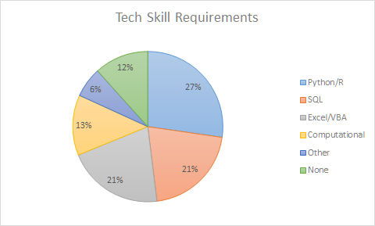
Handshake study shows
recruiters emphasize
analytical background
88% of jobs require some form of technical skills
Excel/VBA, SQL, and Python/R preferred
66% of interviews had a Business Case portion
Emphasis on analytical skills over technical coding knowledge
Source: HandShake Investigation
Notes:
FIX THIS SLIDE

Slide 8
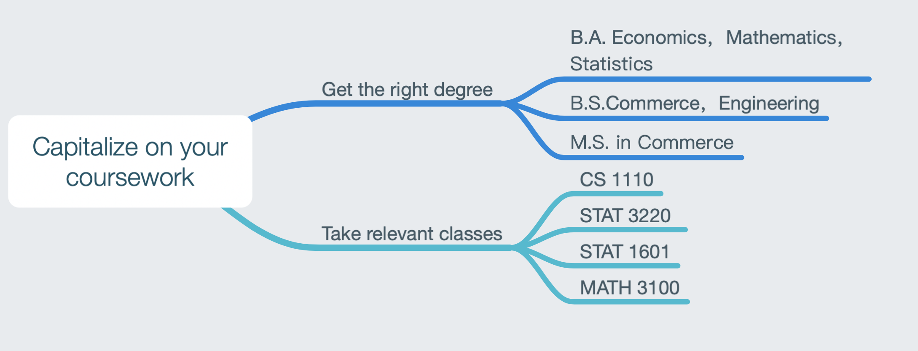
Capitalize on your coursework

Slide 9
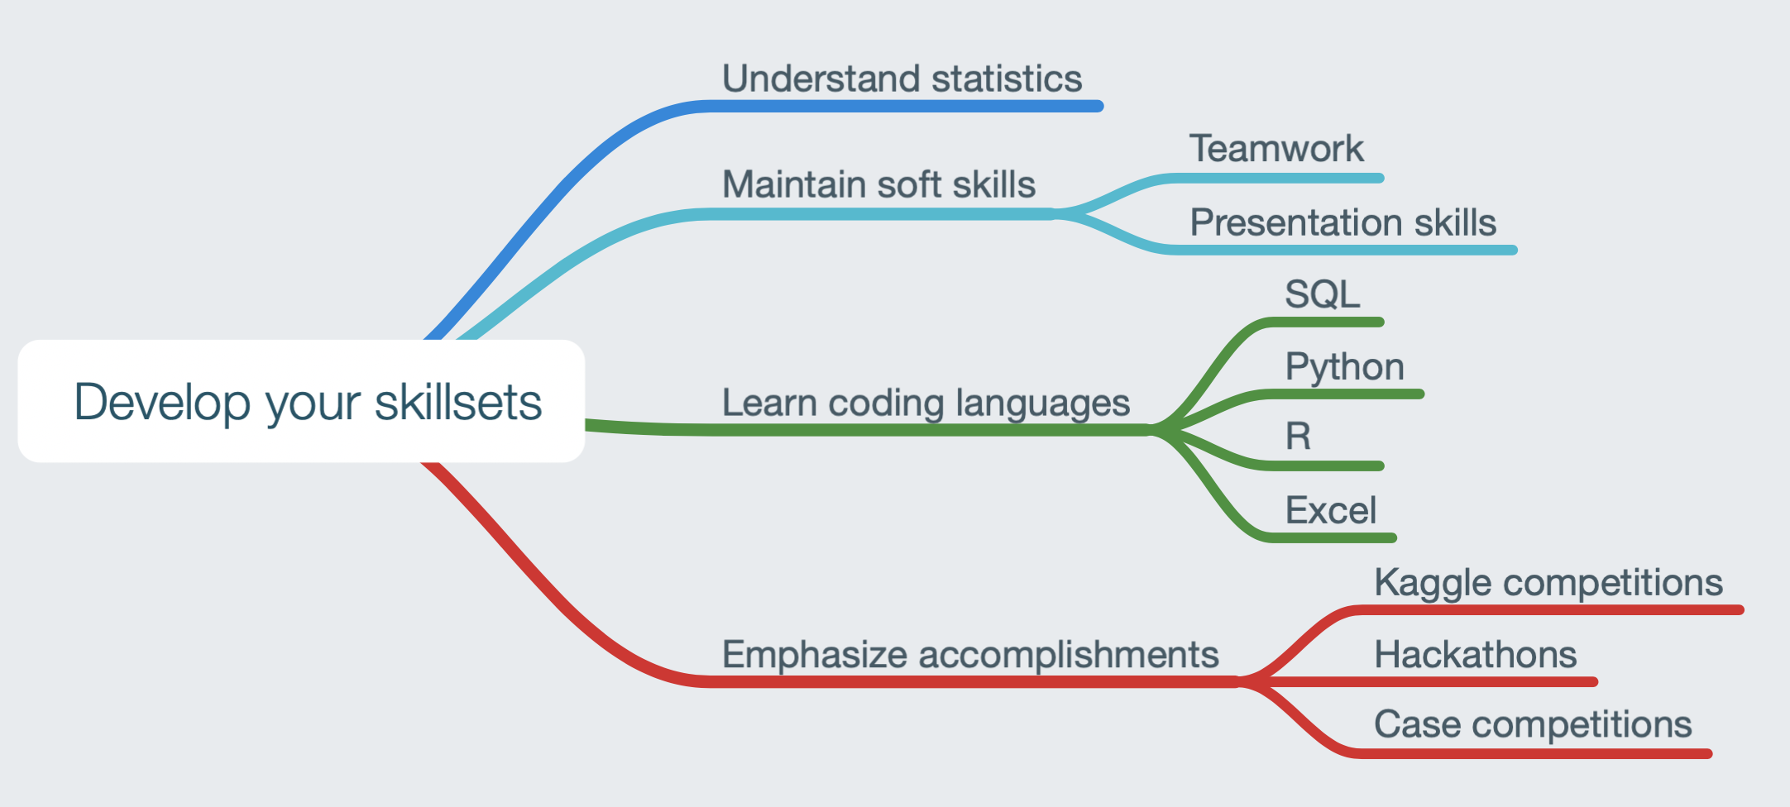
Develop your skillsets

Slide 10
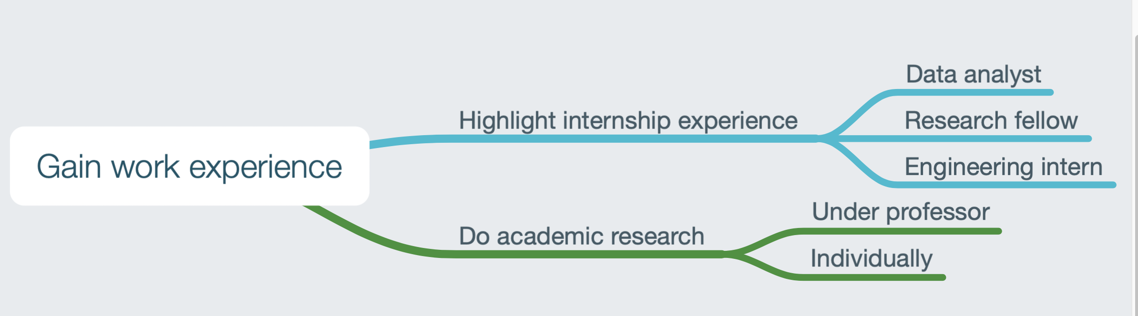
Gain work experience

Slide 11
ASPIRATIONS
Why work in Business Analytics?
2

Slide 12
Nationally, Business Analysts make high salaries
$41k
Median: $58k
$83k
10%
25%
50%
75%
90%
Business Analysts make $58k, which is 16% more than the average starting salary of college grads.
Source: payscale.com
Notes:
Meg

Slide 13

UVA McIntire students make even more
$76,575
$9,167
$78,500
$7,500
$69,000
$8,000
Source: 2017 McIntire Destinations Report
Notes:
Meg

Slide 14



Data analytics increases fulfillment because it’s being used for good
“It’s being used to save
and improve lives”
Lillian Pierson,
Founder of
Data-Mania, LLC
Notes:
Tosan

Slide 15
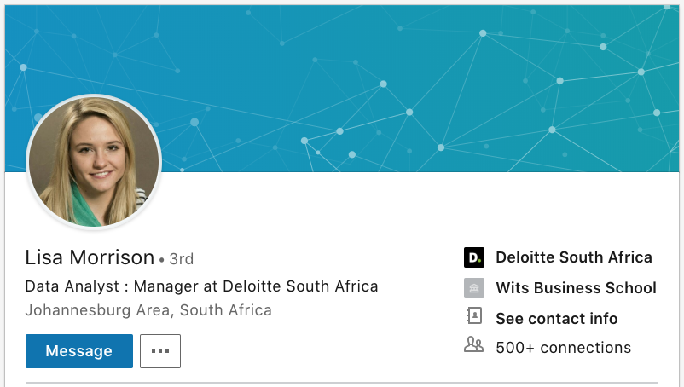
Job Mobility Use Case #1: Deloitte Analytics
“Roughly 60% of those leaving Deloitte [data analytics] end up in a banking institution in a multitude of roles, including ‘customer analytics’ [and] ‘pricing analytics’”
Notes:
Meg
https://www.quora.com/What-is-the-career-prospect-for-someone-in-Deloitte-Data-Analytics
-Financial institutions: By far the largest Hire's of Deloitte Alumni are banking institutions. Roughly 60% of those leaving Deloitte end up in a banking institution in a multitude of roles including "customer analytics", "pricing analytics", "Data management" ETC.. This is probably because due to the high level of awareness of banking institutions of Deloitte as an audit company and their propensity to hire consultants is pretty high thus experiencing the type of work Deloitte data analysts do regularly.
-Industry: Again probably as a resulting of the consulting model - see what data analysts are capable of versus in house ability of a more IT (not business) centric team (The gap is often extremely high) and like to hire based off the experience.

Slide 16






Job Mobility Use Case #2: Deloitte’s GSAP
Deloitte acceptance rates for the top 20 business schools 3x national average
Deloitte offers tuition reimbursement, technology stipend, and access to MBA admissions directors
Source: Deloitte’s Website; Graduate School Assistance Program
Notes:
Tosan
https://www2.deloitte.com/us/en/pages/careers/articles/join-deloitte-graduate-school-assistance-program.html

Slide 17
MARKET REALITIES
How competitive is it to enter Business Analytics?
3

Slide 18
Casing is a barrier to entry
“There was no good reason to spend 250 hours every quarter studying academics that alone would not directly get me a job; I needed to put at least as much effort into learning the one skill that could get me hired. “ - Victor Cheng, Case Interview Secrets
“Generally, people recommend that you do roughly 20 practice case interviews before your first real one. If you’ve got an interview coming up soon, relax- it can be done in less, but to your best to aim for 20 - there’s a big difference and they’ll be able to tell” - Matthew Dell, Deloitte Business Analyst

Slide 19
Casing Use Case: McKinsey’s Process
“I got help from people who were more experienced. I guess for the most part the main barriers are learning how to case, and the time commitment - you need to put in time to get better at cases. ” - UVA Student, McKinsey Summer Business Analyst
McKinsey’s Recruitment Process:
1st Round: 2 case interviews on Grounds
2nd Round: 3 case interviews on site

Slide 20
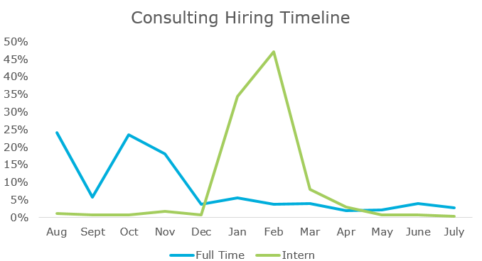
Getting an offer depends on timing
Not only does recruiting start early, but full-time peaks never exceed a level of
25%
Source: TransparentCareer’s guide to recruiting timeline
Notes:
https://blog.transparentcareer.com/mbas/career-guides/top-industries-and-their-mba-recruiting-timelines/

Slide 21
UVA’s demand for these positions is high
4,000 fourth-year UVA students
Approx. 30% are pursuing majors in Business, Technology, and Economics: 1,200 students with relevant majors
Approx. 30% of those apply for Business Analyst positions: 360 students in the market for Business Analyst positions
Last year, McKinsey and Bain took 4 and 9 first year analysts, respectively. That’s an acceptance rate of 3.6%.
Notes:
Last year, McKinsey and Bain took 13 cumulatively. That is they accept 3.6% of UVA applicants.
1 in every 28 students in the market for a full time offer.

Slide 22
Students need to prepare to enter this field
1. Diversify and hone in your skillset
To gain competitive edge, it helps to have an understanding of data analysis, or at the very least, and interest in it! One should seek out opportunities to add more tools to one’s toolbox.
2. Analyze factors that constitute personal success
Prior alignment of one’s personal view of success and what the business/data analytics field has to offer will best ensure one’s continued happiness in this career field.
3. Perform due diligence in case interview preparation
Casing well is a critical component to securing a job offer in this career field. Practice can only add to one’s confidence and competence in one’s case interviewing performance.
Network and seek data-related job openings
Seek jobs that provide exposure to data analytics, data science, or other areas of business.
Notes:
Vivan
Given that their assets, aspirations, and market realities align, COMM 4660 students should attempt entry into the Business and Data Analytics job market. In order to ensure their competitive entry, they should diversify and hone in their skill set (ie. programming experience in Tableau or R,) perform thorough analysis on factors that constitute personal success, and exercise due diligence while preparing for case interviews. The alignment of these factors (assets, aspirations, market realities) and successful entry will provide students with practical technical knowledge, competitive compensation, wide market exposure, and a myriad of exit opportunities.

Slide 23
ALIGN YOUR ASSETS, ASPIRATIONS,
MARKET REALITIES
TAKE ACTION
GO FORTH AND ENTER THE MARKET
Notes:
The student’s predicted success in this market relies heavily on the assumption that they are in good academic standing, are interested in data analysis, and are driven to invest the time needed for job and interview preparation. In the event that the student so chooses not to enter, there are few risks. However for the student that does, the opportunities are immeasurable.

